Slide 1
Step by step Membership to digital payslips
By direct access

Slide 2
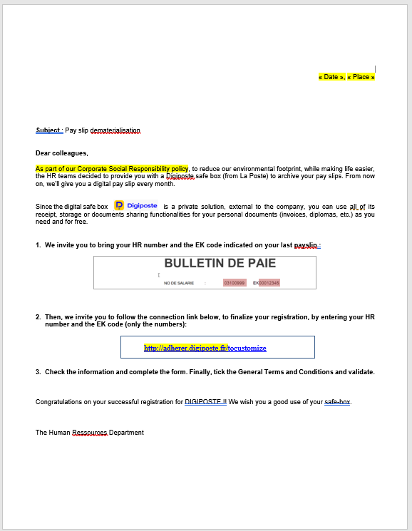
Access to the membership page
Go to the URL you have received by mail or communicated by your employer
In most cases, the URL address follows one of the following formats:
adherer.digiposte.fr/company_name
adherer.digiposte.fr/12-12345

Slide 3
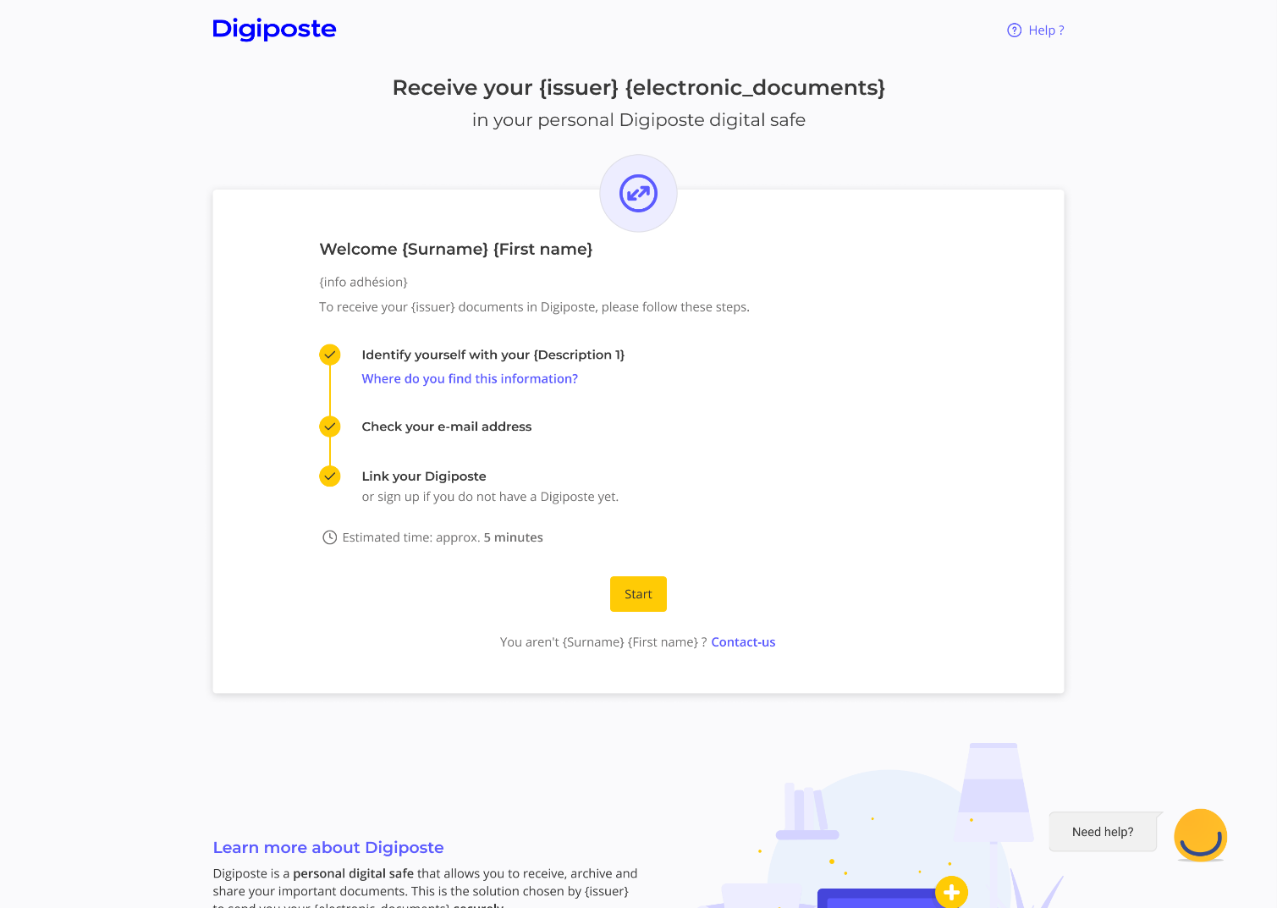
Main screen
3 steps and only 5 minutes will be required in order to access your payslips.
Need help?
Check our chatbot or our online help (in french).

Slide 4
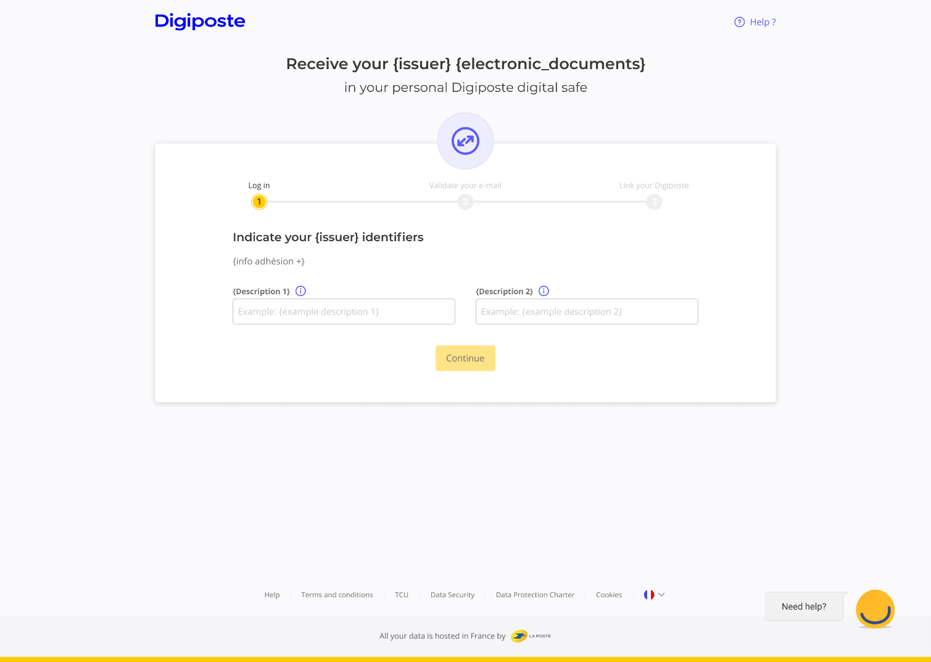
Identify
Identify yourself thanks to your HR ID and security code communicated by your employer
To know how to find those info, click on the information bullet (i)

Slide 5
If you already have a Digiposte
or a LaPoste.fr account

Slide 6
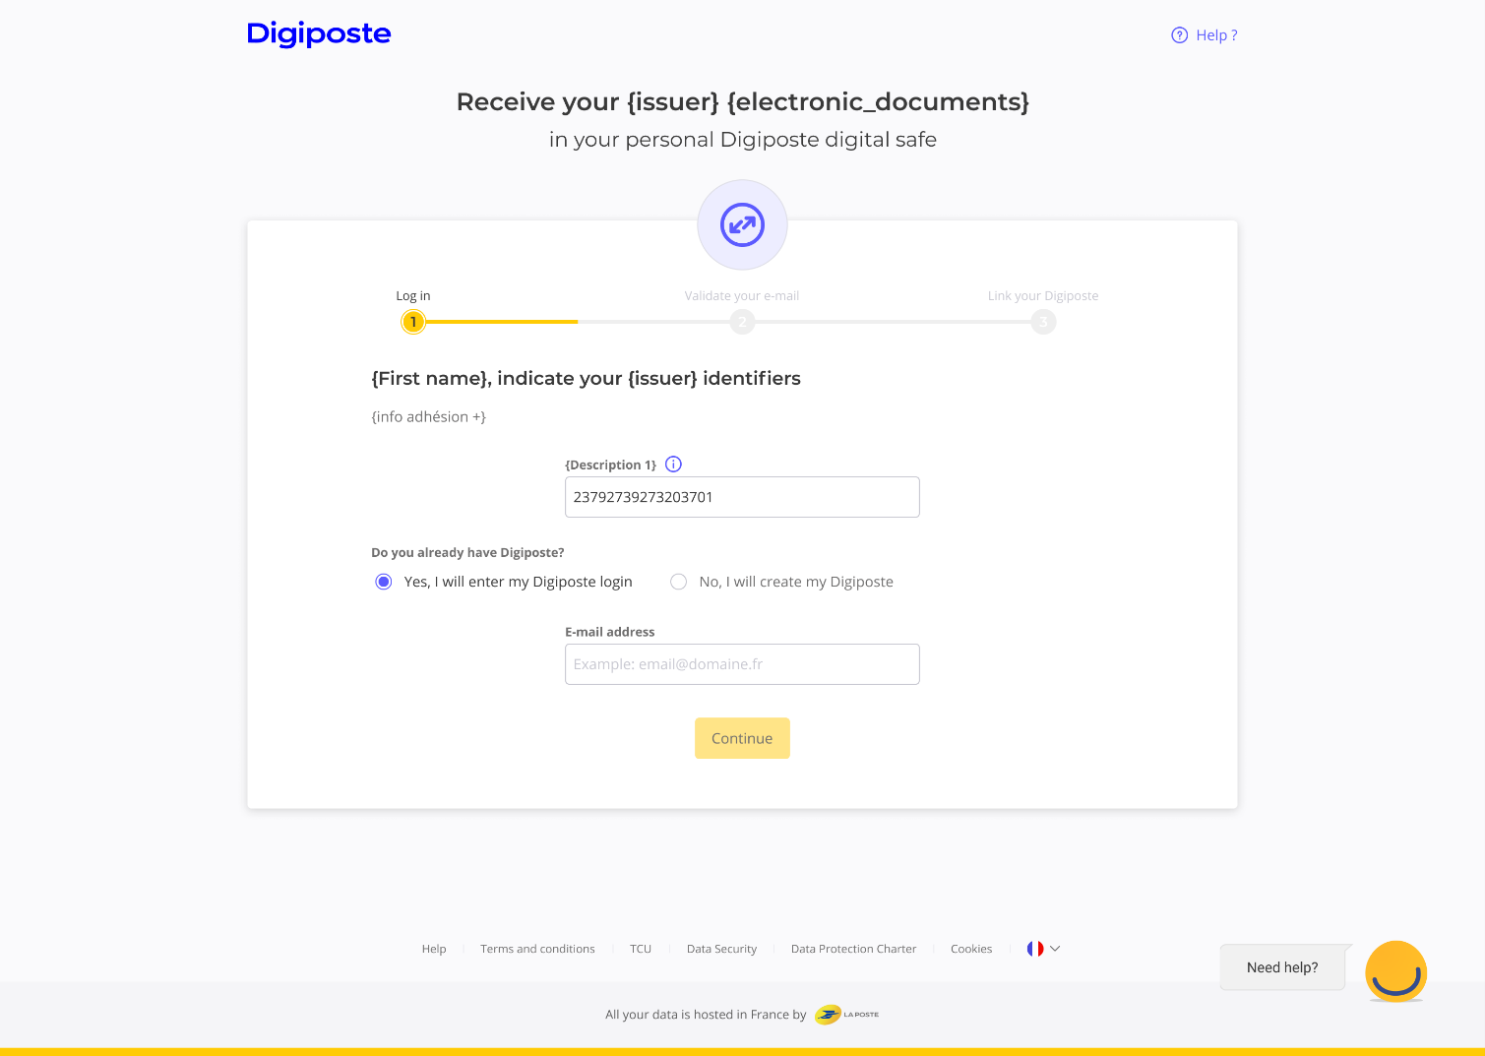
Fill in you email set up for Digiposte
Indicate if you already own a Digiposte login
If you already purchased an item on LaPoste.fr (stamp, recorded letter…) you can also enter the email used for your LaPoste.fr account to identify yourself
If yes, fill in the email linked to your Digiposte

Slide 7
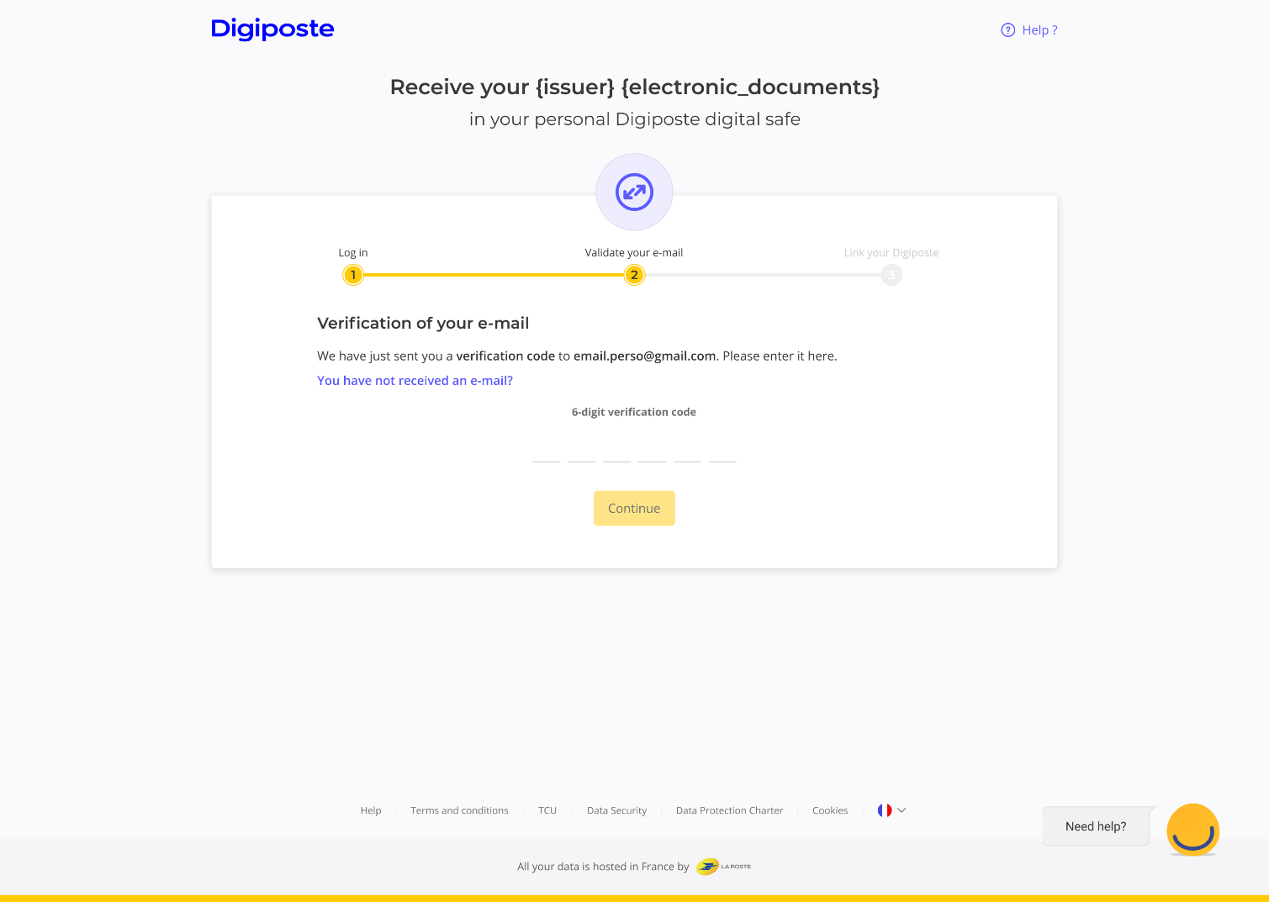
Verify your email address
Enter the verification code which was sent to your email address
The email filled is incorrect?
Click on “you have not received an email?” in order to modify it.

Slide 8
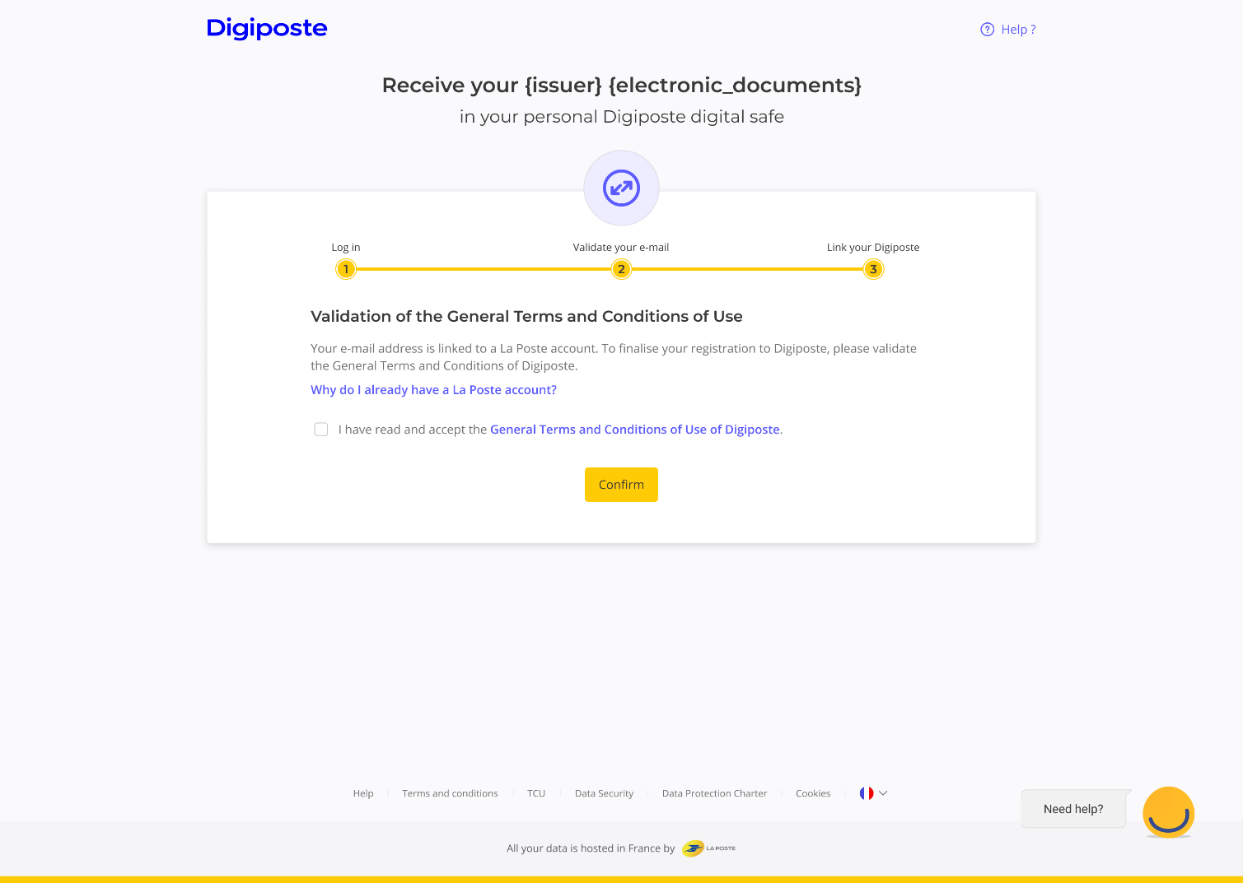
Validate the General Terms and Conditions of Use
If you connect yourself using your La Poste ID, check the box recognising having considered the General Terms and Conditions of Use
This screen only appears if you already have a Digiposte.

Slide 9
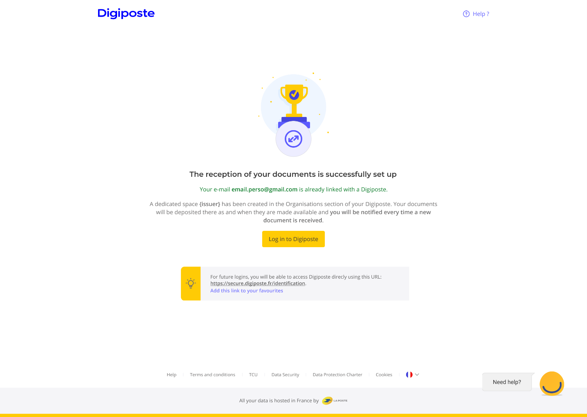
Access your payslips and furthermore
Click on “Log in to Digiposte” in order to access your Digiposte and consult your documents
You can find your payslips after selecting your company in the “organisations” or “safe” sections in Digiposte

Slide 10
If you don’t have a Digiposte
or Laposte.fr account

Slide 11
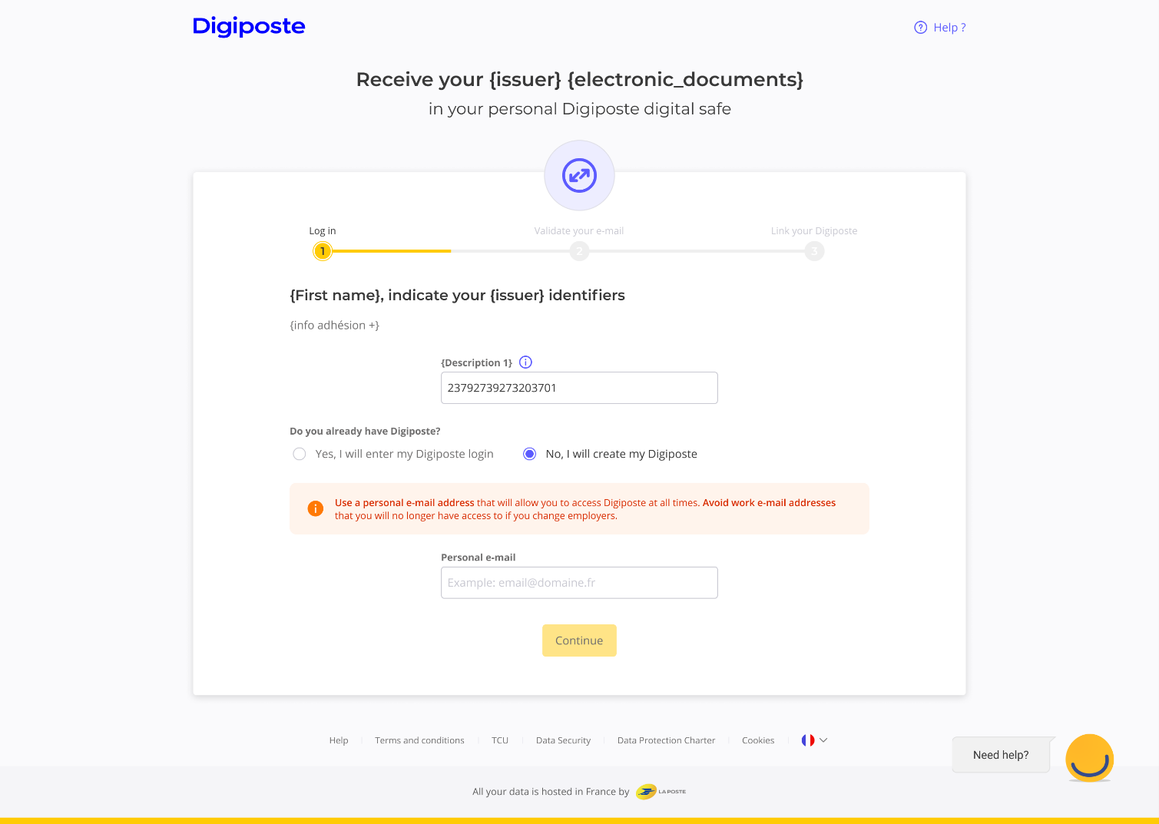
Define your login ID to Digiposte
If you have a Digiposte ID, type your desired email to create your Digiposte
A La Poste account will therefore be created. From your laposte.fr account, you’ll be able to track your packages, buy stamps, edit recorded letters...
Mind using a personal email in order to access your Digiposte even though you no longer are working for your company

Slide 12
Verify your email address
Enter the verification code which was sent to your email address
The email filled is incorrect?
Click on “you have not received an email?” in order to modify it.

Slide 13
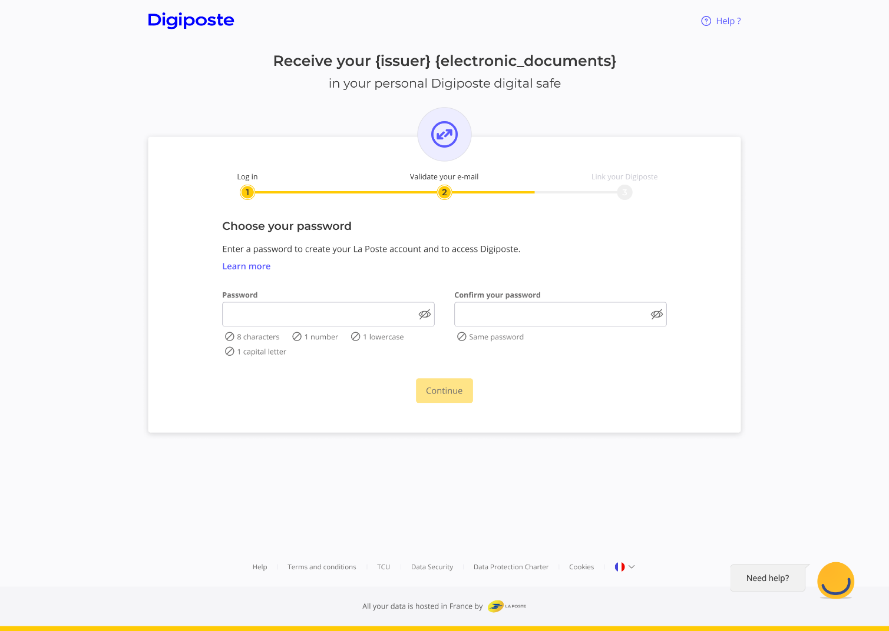
Define your password
Define the password you will use to log in to Digiposte
For a higher and stronger security, your password must be at least 8 characters long, with at least one number, one lowercase letter and one capital letter

Slide 14
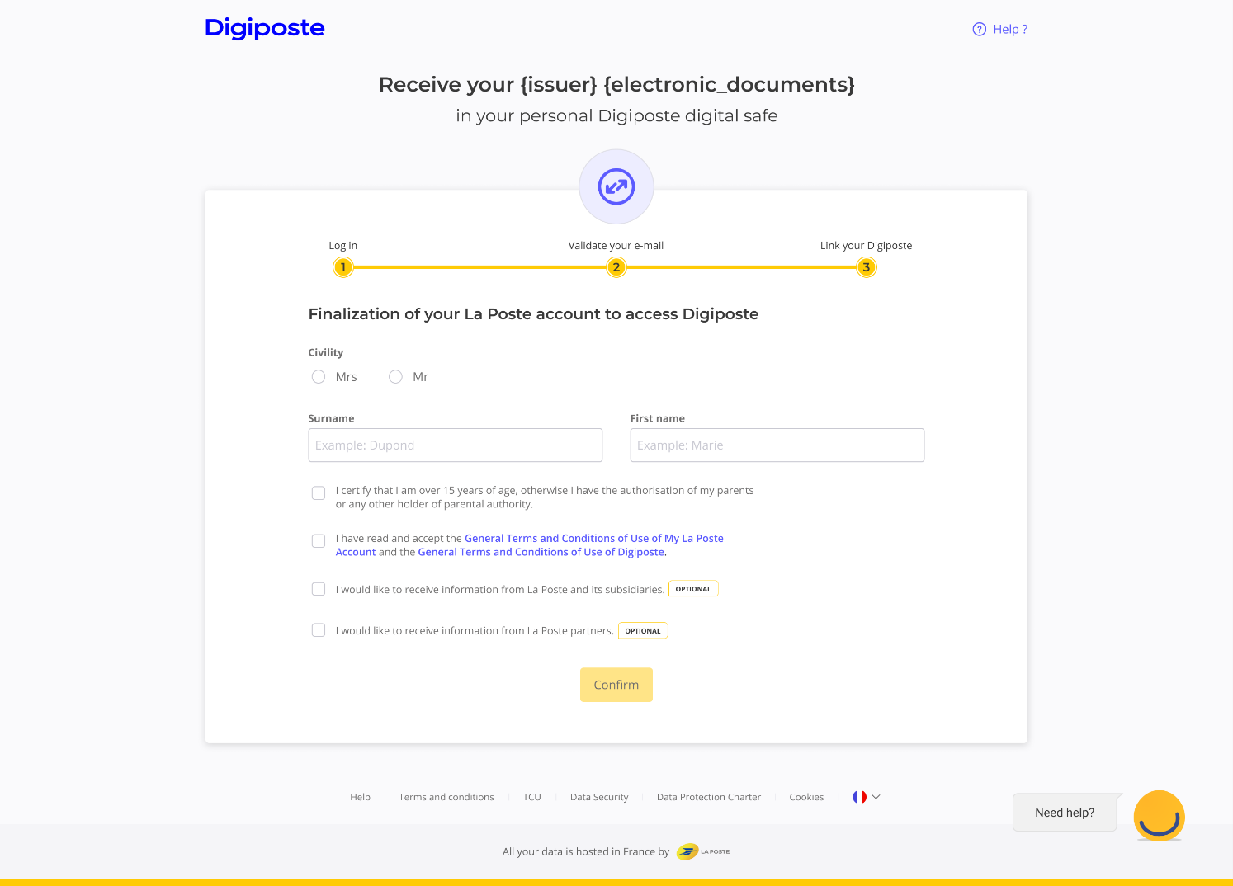
Create your Digiposte
Fill in the form with your civility, your surname and first name

Slide 15
Access your payslips and furthermore
Click on “Log in to Digiposte” in order to access your Digiposte and consult your documents
You can find your payslips after selecting your company in the “organisations” or “safe” sections in Digiposte

